Slide 1
Types
of
Communication

Slide 2
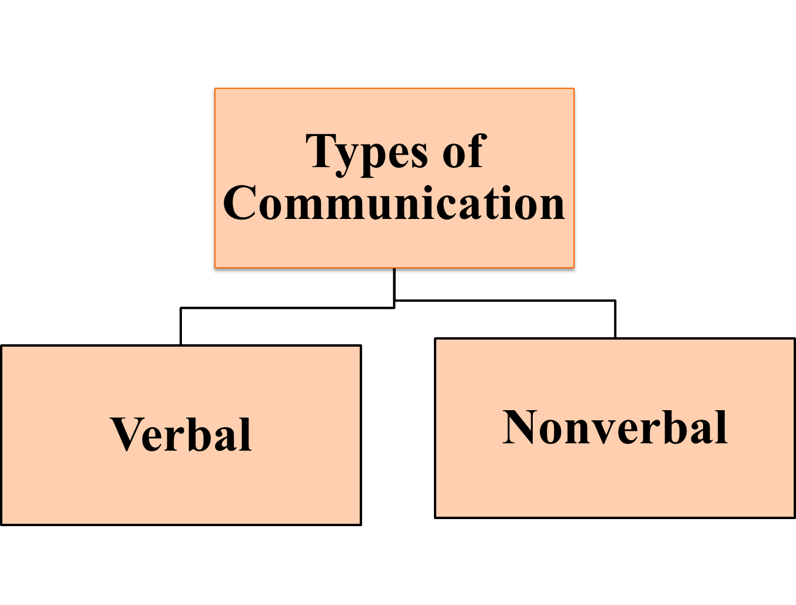

Slide 3

VERBAL COMMUNICATION
The sharing of information between individuals by using speech or writing.
Verbal communication is best suited to convey specific information, and is better suited to communication through technology over long distances.

Slide 4
ROLE OF LANGUAGE IN VERBAL COMMUNICATION
What is Language?
Edward Sapir:
“Language is not only a vehicle for the expression of thoughts, perceptions, sentiments, and values characteristic of a community; it also represents a fundamental expression of social identity.”
Benjamin Whorf:
“Language shapes thoughts and emotions, determining one’s perception of reality.”

Slide 5
Do you think that human language is learned or inherited?

Slide 6
HUMAN LANGUAGE
Human language is unique because it is a symbolic communication system that is learned instead of biologically inherited.
However, the ability to acquire any language whatsoever is innate.
Linguists believe that human beings have a mechanism which is called Language Acquisition Device (LAD).

Slide 7
IMPORTANCE OF LANGUAGE
Language is a tool to
learn knowledge
transmit information
express feelings, emotions and ideas
forge cultural ties
construct social identity

Slide 8
VERBAL GENDER AND CULTURAL DIFFERENCES
When communicating verbally, men tend to seek and offer solutions, while women tend to focus on empathy (John Gray, “Men are from Mars; women are from Venus”).
Men are more goal-oriented while women are more relationship-oriented.
People from different cultures also differ in how they express themselves, even when the literal meanings of words are translated into the native language of the listener.
“Yes" --------------"maybe” Asian & Pacific Islanders
“Yes" --------------binding commitment USA, Canada & Northern Europe

Slide 9
…………………………………CONTINUED
Examples:
Yes---------I heard what you said.
Yes---------I understand what you said.
Yes---------I can see this is important for you.
Word Your Questions Carefully:
Not carefully worded questions
Do you want to go to dinner now or wait until the rush –hour is over?
Aren’t you coming to dinner?

Slide 10




NONVERBAL COMMUNICATION
“The World Beyond Words”

Slide 11
NONVERBAL COMMUNICATION
“Messages expressed by nonlinguistic means.”
  It includes silent behaviors, environment, artifacts, and vocal intonation
  It is a powerful mode of communication

Slide 12
RELATIONAL NATURE OF NONVERBALS
Nonverbal communication assists with:
  Identity management- Getting others to see us as we want to be seen; there are several ways of managing identity nonverbally:
"Manner" refers to the way we act.
"Appearance" involves the way we dress, artifacts we wear, etc.
"Setting" involves the physical items we surround ourselves with.
  Defining our relationships: Level of intimacy
  Conveying Emotions: For expressing emotions we don’t want to express, can’t express, or don’t know we’re feeling

Slide 13
NONVERBALCOMMUNICATION IS AMBIGUOUS
The same nonverbal can have multiple meanings
For example:
  “I’m feeling content” smiles
  “I’m feeling a little stressed” smiles
  “I’m a bit sad” smiles
  “I can’t believe you just did that” smiles
  “How do I get out of this conversation?” smiles

Slide 14

NON-VERBAL GENDER AND CULTURAL DIFFERENCES
Women tend to be better at interpreting non-verbal messages than men
Men are also less adept at sending subtle non-verbal messages.
Cultural differences in non-verbal communication can create misunderstandings
For example, among North Americans, nodding the head means "yes," while among Japanese, it means merely "I’m listening" according to Wang De-hua and Li Hui of the Ningbo Institute of Technology.

Slide 15
Improving your nonverbal communication skills
Nonverbal cues can speak louder than words
Eye contact
Facial expression
Body movement
Space
Time
Appearance

Slide 16



Eye Contact
Windows to the soul
Best predicator of the true feelings of the speaker
Sustained eye contact
Brief eye contact
Good eye contact
Attention
Respect
Favourable response
Sincerity
Confidence
Truthfulness

Slide 17
Facial Expression
Human face can display over 250,000 expressions
Men and women have been found to be equally expressive
Men show the most emotion in the lower left quadrant of their face
Women show emotion over their whole face
Raising or lowering eyebrows
Squinting the eyes
Clenching the jaw
Smiling broadly

Slide 18

Posture and Gestures

Slide 19
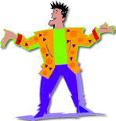
A person’s posture can convey anything from high status and self confidence to shyness and submissiveness.
Leaning towards a speaker
Pulling away or shrinking back
Similarly, gesture can also com-
municate thoughts via simple
movements.
Meaning might differ in various cultures

Slide 20
VOICE
Consists of vocal tone, speed, pitch, volume, number and length of pauses, and disfluencies (“um”s, “ah”s), etc.
Affects how others perceive us
  Stereotyping (e.g., accents, vocabulary, grammar)
Meaning of speech can also be altered significantly by tone and character of voice
Examples:
Are you here?

Slide 21
Try saying “You are my friend” to convey the following meanings:
You really are? I hadn’t realized that.
That ploy won’t work. I told you we’re through.
You couldn’t possibly be my friend after what you did!
Mine? Am I the one who is your friend?
You? I didn’t think you are anybody’s frind.

Slide 22

SILENCE
Can communicate contentment, awkwardness, anger, respect, thoughtfulness, empathy
Can also be disconfirming

Slide 23

PROXEMICS
It is the human use of space and it deals with the amount of space people consider necessary to have between themselves and others.
Personal Space
Intimate Zone
Personal Zone
Social Zone
Public Zone
You are here

Slide 24

Space
Geographical space belonging to us
(your room, your bed, your apartment, etc.)
How we order the space around us tells something about our objectives
People reveal themselves in the design and grouping of their furniture
Barrier Behaviour
Backing up, putting something between us, breaking eye contact

Slide 25

TIME/CHRONEMICS
How we structure and use our time tells visitors about our personality and attitude
Our use of time reflects:
  Power/status
  Cultural norms
  Expectations

Slide 26



Appearance
Personal Appearance
The way you look- your clothing,
grooming and posture- telegraphs an
instant nonverbal message about you.
Judgments about your personality, status, credibility and potential

Slide 27
…………………CONTINUED
Eye appeal of official documents
The way a memo, letter, report or an email looks like can have a positive or negative impact on the receiver.
Envelops through their postage, printing and stationary can suggest routine, important or junk mail.

Slide 28
Some Guidelines for Improving Nonverbal Communication

Slide 29
Establish and maintain eye contact
Use posture to show interest
Improve your decoding skills
Probe for more information
Avoid assigning nonverbal meanings out of context
Appreciate the power of appearance
Observe yourself on video
Enlist friends and family

Slide 30
Thank You

